Slide 1

H-Bridge with PWM
Digital electronics

Slide 2
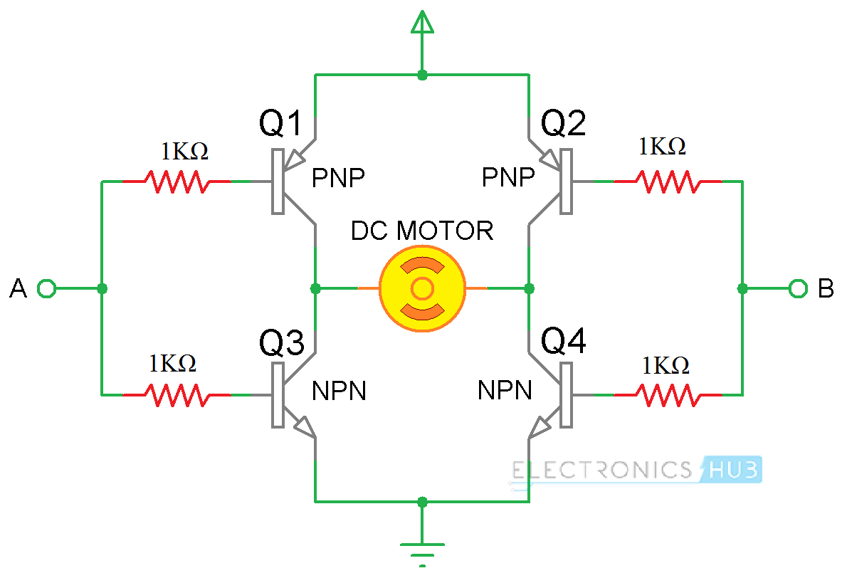
What is H-bridge: -Electronic circuit that looks like letter H. -Controls the flows of current to load. -Commonly used to control speed and direction of a brushed dc motor. -This motor driver dose not cost any more than $1.25 USD making it super cheap.

Slide 3
Application of H-Bridge: Motor driver circuit Robotics technology In modern battery charger for electrical vehicles

Slide 4
Advantages of H-Bridge Circuit
1. Very high efficiency.
2. Very low loss.
3. This circuit can be placed in small places.

Slide 5
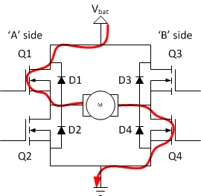
if Q1 and Q4 are turned on, the left lead of the motor will be connected to the power supply, while the right lead is connected to ground. Current starts flowing through the motor which energizes the motor in (let’s say) the forward direction and the motor shaft starts spinning.

Slide 6
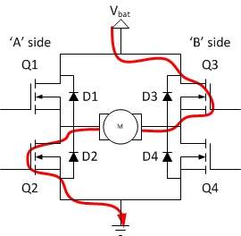
If Q2 and Q3 are turned on, the reverse will happen, the motor gets energized in the reverse direction, and the shaft will start spinning backwards.

Slide 7
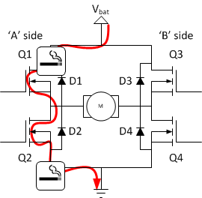
In a bridge, you should never ever close both Q1 and Q2 (or Q3 and Q4) at the same time. If you did that, you just have created a really low-resistance path between power and GND, effectively short-circuiting your power supply. This condition is called ‘shoot-through’ and is an almost guaranteed way to quickly destroy your bridge, or something else in your circuit.

Slide 8
How to check if H-Bridge is working or not: Place the Voltmeter across the resistor and u should see a variable voltage depending on your PMV into the bridge and a polarity change depending on which direction and then 0V hen it's supposed to be stopped

Slide 9
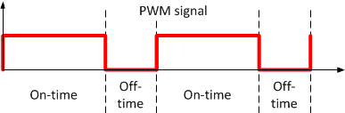
PWM Pulse-width modulation (PWM), or pulse-duration modulation (PDM): “Voltage, duty cycle, time” Powerful technique for controlling analog circuits with a microcontroller's digital outputs It's used to control to inverter output voltage and to reduce the harmonic content in the output voltage.

Slide 10
why PMW is used in inverter: To give a steady output voltage of 230 or 110 v AC irrespective of a load PMW useful for motor : Controlling amount of power delivered to load without dissipating any wasted power

Slide 11
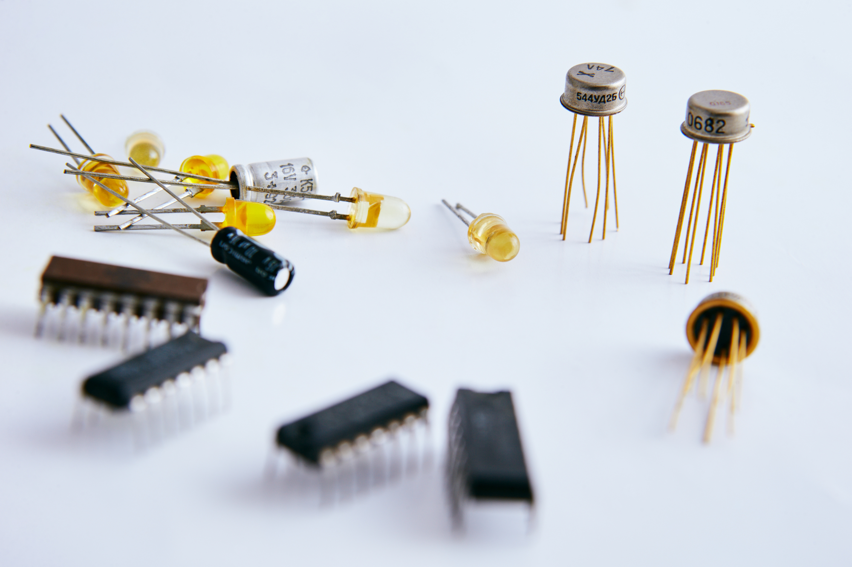
Components used for projects: Capacitor 100 microfarad Tip142 Tip147 2n2222 10k resistor 1k resistor Heat think Rosetta 3 inputs Rosetta 2 inputs Transistors Supply PCB Breadboard Jumpers
Total Price for BreadBoard:157.5 EGY
Total Price for PCB :112.5 EGY Without Driller & Welding machine

Slide 12

Thank You

